Slide 1




Option 1: Load examples before start (note: google account needed for download and testing without: only reading possible):
Example 1
https://t1p.de/ML-exp1
Example 2
https://t1p.de/ML-exp2
Option 2: Download exercises and presentation and run them in your environment of choice:
https://github.com/SilviaVock/IEEE-MMM-2023-Hands-on-tutorial

Slide 2


Tutorial: Machine Learning in Magnetism
Basic introduction to Machine Learning
in a physical context
Silvia Vock

Slide 3



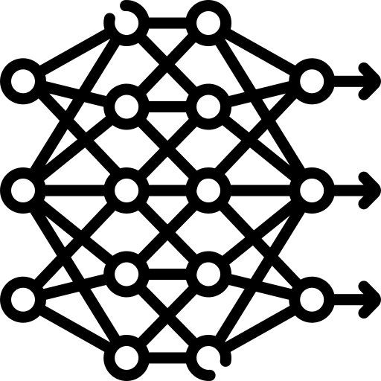


Content
Machine Learning – Overview and Basic Understanding
Hands - On 1: Simple workflow for a classification task
2. The heart of Machine Learning: Fitting a Regression
3. Focus: Neural Networks
Hands - On 2: Linear regression from scratch
4. Short Excursion: Dependable Machine Learning
5. Short Excursion: Physics - Informed Deep Learning

Slide 4
Content
Machine Learning – Overview and Basic Understanding
Hands - On 1: Simple workflow for a classification task

Slide 5


ML principle: Data driven knowledge discovery
measurement data
algorithm
answer to research question
Machine Learning
program modules with adjustable elements that are autonomously tuned in a learning process
static program codes

Slide 6
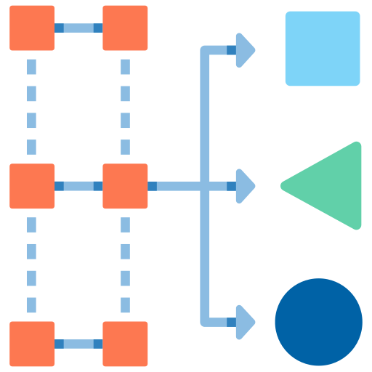
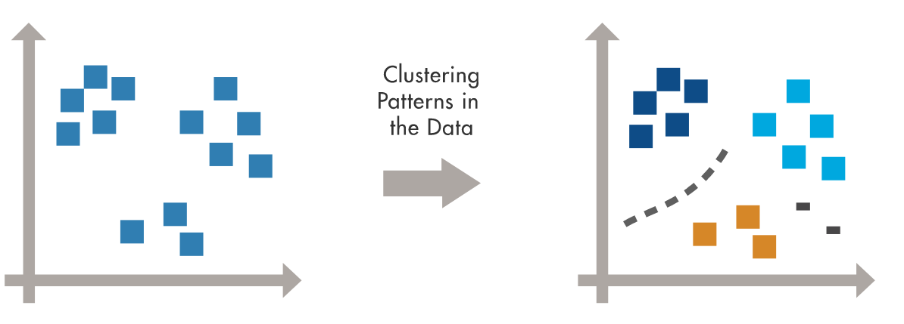
Basic Machine Learning paradigms
Labeled Data
Direct Feedback
Predict outcome
Supervised Learning
No labels
No feedback
Find hidden structure in data
Unsupervised Learning
Reward
Decision process
Reward system
Learn series of actions
environment
Reinforcement Learning
State
Action
agent
Raschka, Mirjalili, Python Machine Learning, Packt 2019

Slide 7
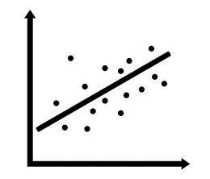
Basic Machine Learning paradigms
Labeled Data
Direct Feedback
Predict outcome/future
Supervised Learning
classification
ML algorithms e.g.:
Decision Trees
Naive Bayes
Nearest Neighbor
Support Vector Machines
Linear Regression
Neural Networks
regression
Raschka, Mirjalili, Python Machine Learning, Packt 2019

Slide 8
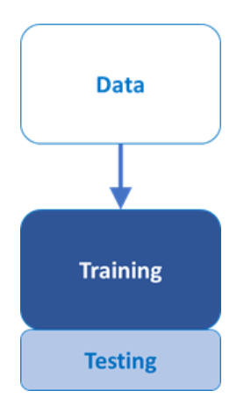
Machine Learning – Basic Workflow
input
output
ML
1. training
training data
x_{train}
ŷ
label
= ?
simulations
manually with expert knowledge
additional measurements
y_{train}
comparison
ML
x_{test}
ŷ
test data
2. validation
= ?
y_{test}
comparison
test score
ML
?
new data
x
ŷ
3. prediction
?
?

Slide 9
Why machine learning and why now?
Why?
evaluation of large datasets: e.g.
materials discovery: materials databases (SuperCon)
scientific imaging (SEM, light microscopy)
…
large feature space and complex relationships + lack of physical models
ML results already outperform classical numerical algorithms (speed, accuracy)
Why now?
algorithms + amount of data + computing power

Slide 10
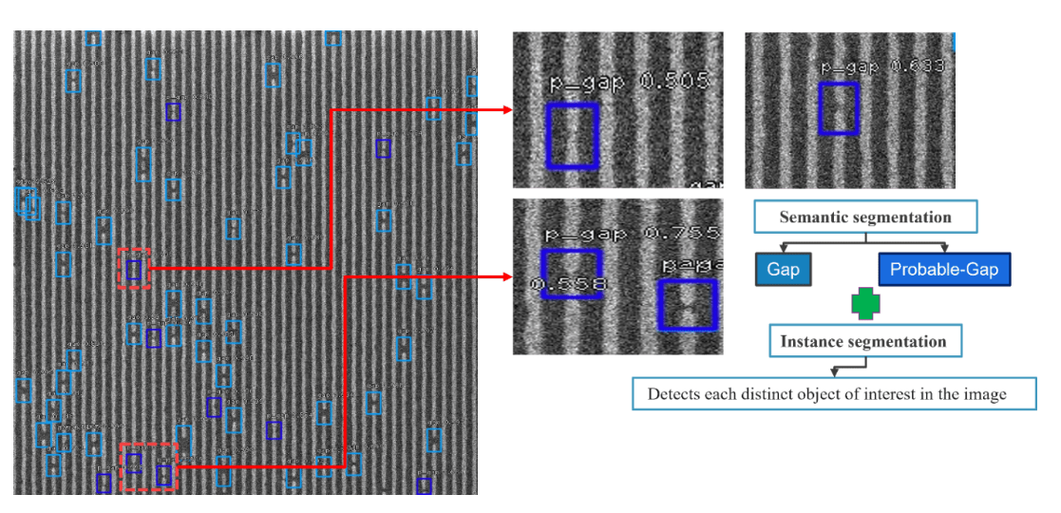

Sem classification
Data and tasks in physics research: SEM image classification
semiconductor manufacturing
defect detection, localization and classification in line space patterns created by lithography
https://learnopencv.com/ensemble-deep-learning-based-defect-classification-and-detection-in-sem-images/

Slide 11
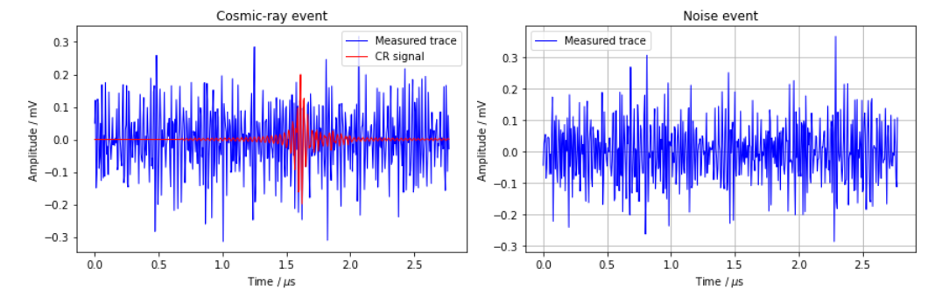
Data and tasks in physics research: Signal identification
https://nbviewer.org/github/DeepLearningForPhysicsResearchBook/deep-learning-physics/blob/main/Exercise_09_2_solution.ipynb
Data:
Time series of electromagnetic radiation generated in the atmosphere
Task:
identification of cosmic-ray events in signal traces with a high SNR

Slide 12

Quick start: steps of training a classification model with scikit-learn
#import data
df = read_csv(‘https://‘, delimiter = “,“)
#extract input and output
X =
Y =
#split
X_train, X_test, Y_train, Y_test = train_test_split(X,Y,…)
#build model
model = MLPClassifier()
model = model.fit(X_train, Y_train)
#evaluate model
model.score(X_test, Y_test)
#use model for prediction
Y_predict = model.predict(X_test)

Slide 13
Quick start without theory CODING EXAMPLE 1: Simple MNIST classifier
https://t1p.de/ML-exp1

Slide 14
Content
Machine Learning – Overview and Basic Understanding
Hands - On 1: Simple workflow for a classification task
2. The heart of Machine Learning: Fitting a Regression
3. Focus: Neural Networks
Hands - On 2: Linear regression from scratch
4. Short Excursion: Dependable Machine Learning
5. Short Excursion: Physics - Informed Deep Learning

Slide 15
CODING EXAMPLE 2: Regression from scratch
https://t1p.de/ML-exp2

Slide 16
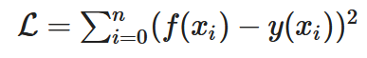
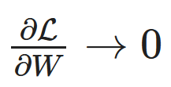
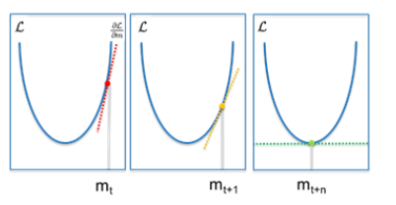
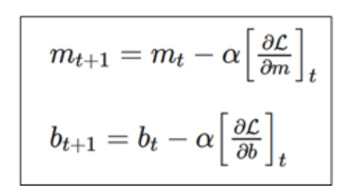
Summary of important terms
loss function, objective function, cost function
learning: minimizing loss
minimizing loss: Gradient descent
learning rate

Slide 17
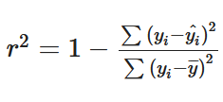
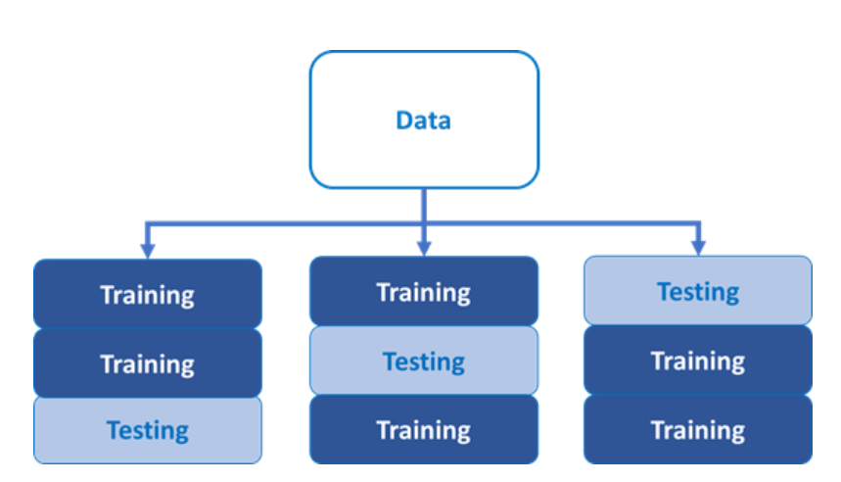
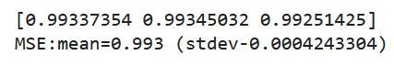
Summary of important terms
data split
evaluation
cross-validation

Slide 18
Content
Machine Learning – Overview and Basic Understanding
The heart of Machine Learning: Fitting a Regression
Focus: Neural Networks
Short Excursion: Dependable Machine Learning
Short Excursion: Physics - Informed Deep Learning
Hands - On 1: Simple workflow for a classification task
Hands - On 2: Linear regression from scratch

Slide 19
Basics of Neural Networks

Slide 20
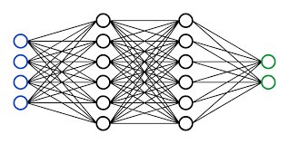
Neural Networks
network nodes
Experimental or simulated
physical data
result (class, prediction)
input
layer
hidden
layer
output
layer

Slide 21
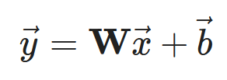
Linear mapping and displacement
Input
x
Output
y
output
input

Slide 22
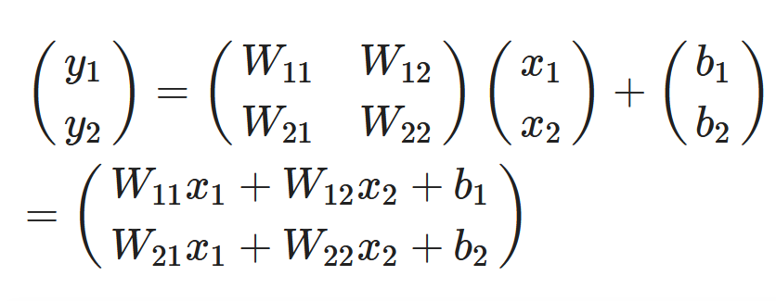
Linear mapping and displacement
x1
y1
x2
y2
output
input

Slide 23
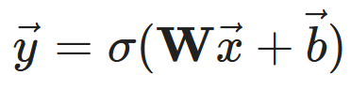
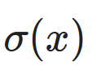
Activation
x1
x2
output
input
σ(y)
activation function
ReLu
sigmoid
hyperbolic tangent

Slide 24
Neural Network
input
hidden layer
output
y₁ = W₁₁x₁ + W₁₂x₂+b₁
W₁₁
x₁
σ(y₁)
c₁
W₁₂
z
z = c₁σ(y₁) + c₂σ(y₂)+d
W₂₁
c₂
W₂₂
x₂
σ(y₂)
y₂ = W₂₁x₁ + W₂₂x₂+b₂

Slide 25
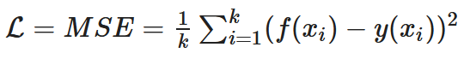
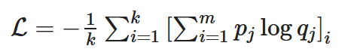
Loss function
the heart of the optimization process
Other names:
Objective function
Cost function
Regression: MSE
expected target value
network prediction with input x
Classification: cross-entropy
GOAL: Minimizing Loss

Slide 26
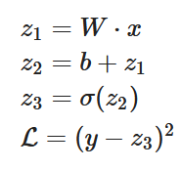
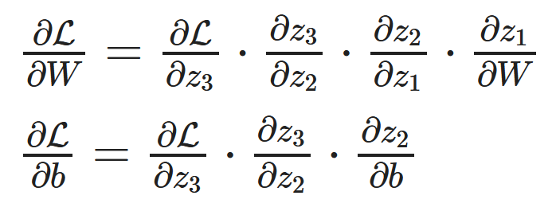
Minimize loss function → Backpropagation: Gradient descent
1. Feedforward step
z₁
z₂
z₃
x
*
+
σ
W
b
L
y
2. Backpropagation
achieve the minimization of the loss function
calculate partial derivates of with respect to network parameters
Erdmann et al., Deep learning in physics, 2021

Slide 27
Mastering model building

Slide 28
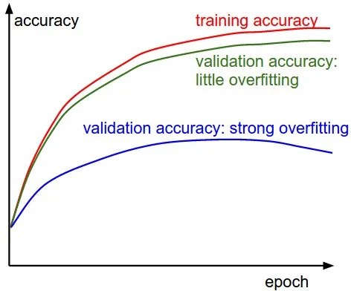
Monitoring: Validation Curves

Slide 29
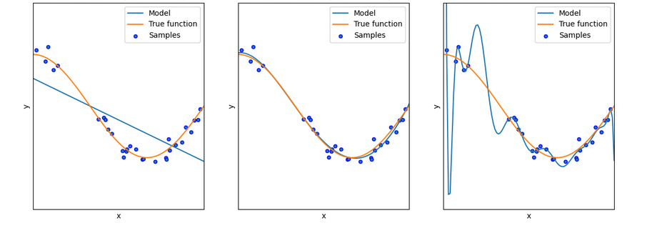
Underfitting/Overfitting

Slide 30
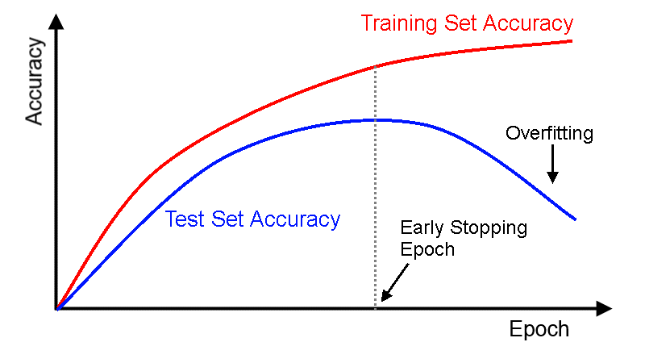
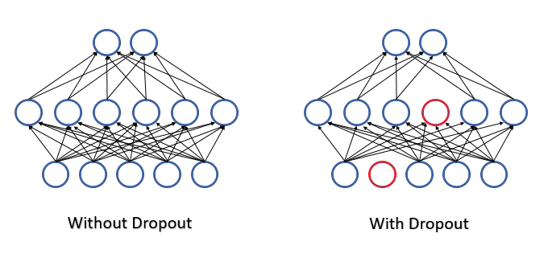
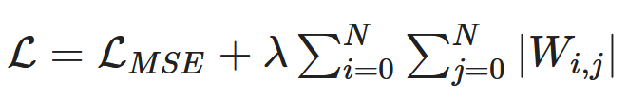
Reducing Overfitting: Regularization
„Regularization is any modification we make to a learning algorithm that is intended to reduce its generalization error but not the training error.“ *
Methods e.g.:
Early stopping
https://www.researchgate.net/publication/355020694_Deep_learning_models/figures?lo=1
https://www.mql5.com/de/articles/9112
Dropout
Parameter norm penalties
penalty term
*citation of Ian Goodfellow et al. in „Deep learning for physics research“, p. 58

Slide 31
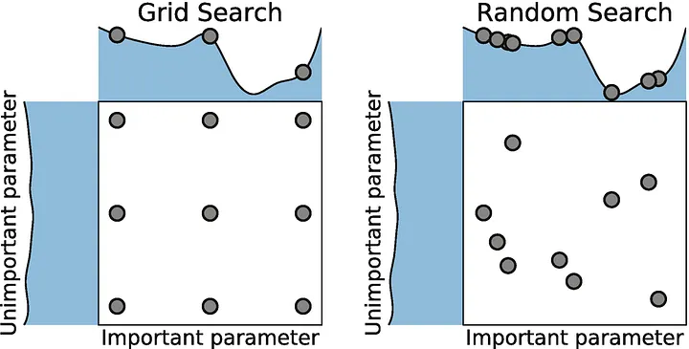
Hyperparameters and their optimization
Basic parameter: values that are derived from the learning, like node weights and bias
Hyperparameter: parameter whose value is used to control the learning process
Number of hidden layers
Number of network nodes in a layer
Choice of activation function
Initialization of network parameters
Coefficients of the regularization terms
Batch size
Learning rate
Learning strategy
Methods:
https://medium.com/@cjl2fv/an-intro-to-hyper-parameter-optimization-using-grid-search-and-random-search-d73b9834ca0a

Slide 32
Evaluation

Slide 33
Evaluation measures
Regression:
R² - coefficient of determination
MSE
…
Classification:
confusion matrix
accuracy
sensitivity
…

Slide 34
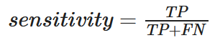
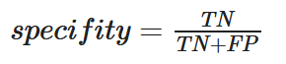
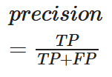
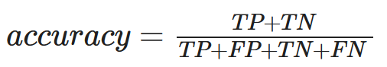
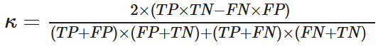
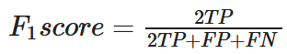
Classification: Confusion Matrix
2-class example
 |  | Predicted Condition
 | Total population = P+N | Positive PP | Negative PN
Actual Condition | Positive P | True Positive TP | False Negative FN
 | Negative N | False Positive FP | True Negative TN
+
-
+
-

Slide 35
Training, Validation, Test
Data
Training data
Test data
Validation data
fit the model
typically the largest part of the overall dataset 60-80%
estimate error of candidate models
iterative phase with training phase
measure performance of final selected model
needs to be truly blind, i.e. test data is held out during the whole iterative training-validation phase

Slide 36
Different networks for different physical tasks
Fully connected networks
Convolutional networks
Recurrent neural networks
input
filters
y_{t}
h_{t-1}
h_{t}
feature maps
x_{t}

Slide 37
Content
Machine Learning – Overview and Basic Understanding
Hands - On 1: Simple workflow for a classification task
2. The heart of Machine Learning: Fitting a Regression
3. Focus: Neural Networks
Hands - On 2: Linear regression from scratch
4. Short Excursion: Dependable Machine Learning
5. Short Excursion: Physics - Informed Deep Learning

Slide 38
Content
4. Short Excursion: Dependable Machine Learning

Slide 39


Robustness
+ noise
predicted label: stop sign
predicted label: ???

Slide 40
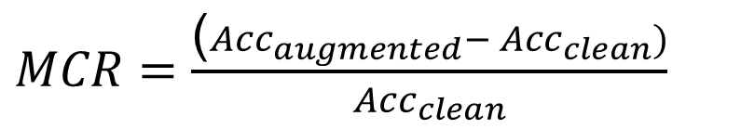
Robustness assessment
Robustness metric:
$MCR=\frac{\text{(}{Acc}_{augmented}− {Acc}_{clean})}{{Acc}_{clean}}$
misclassification
Siedel, Vock, Morozov, Voß: Utilizing Class Separation Distance for the Evaluation of Corruption Robustness of Machine Learning Classifiers, IJCAI_ECAI 2022 eingereicht

Slide 41
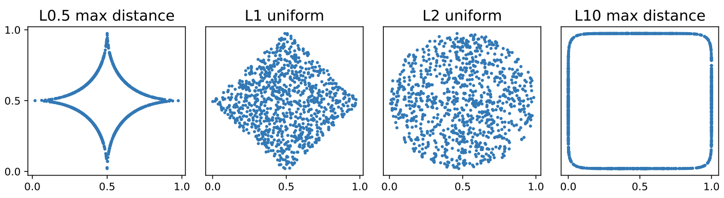
Core Concept – Random Lp-norm Corruptions
Largest possible coverage of pixelwise noise
Combination of various Lp-norms for noise injection
Siedel et al. "Investigating the Corruption Robustness of Image Classifiers with Random Lp-norm Corruptions." arXiv preprint arXiv:2305.05400, 2023

Slide 42
Training with different random Lp-norm corruptions
Siedel, Georg, Silvia Vock, and Andrey Morozov. "Investigating the Corruption Robustness of Image Classifiers with Random Lp-norm Corruptions." arXiv preprint arXiv:2305.05400, 2023

Slide 43
Content
Machine Learning – Overview and Basic Understanding
Hands - On 1: Simple workflow for a classification task
2. The heart of Machine Learning: Fitting a Regression
3. Focus: Neural Networks
Hands - On 2: Linear regression from scratch
4. Short Excursion: Dependable Machine Learning
5. Short Excursion: Physics - Informed Deep Learning

Slide 44
Content
5. Short Excursion: Physics - Informed Deep Learning

Slide 45
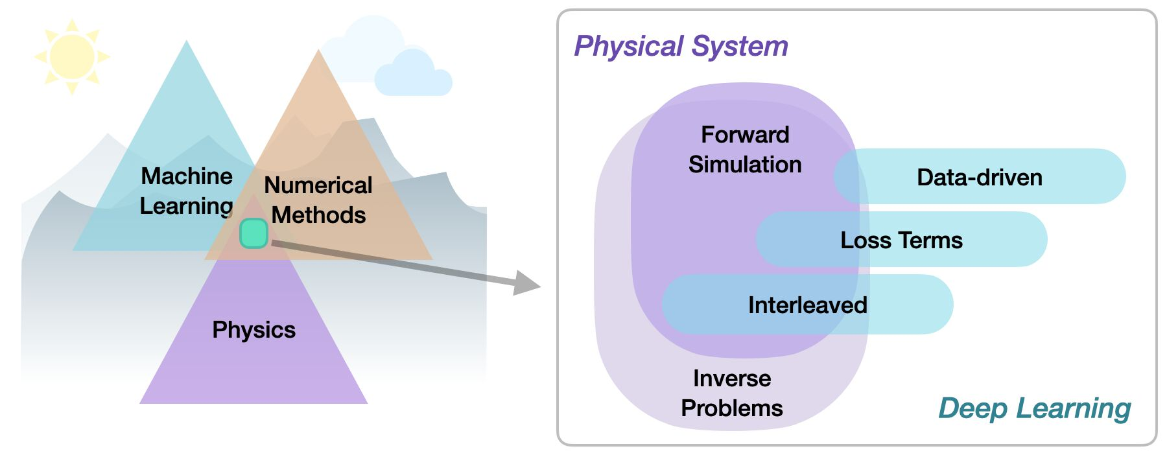
Physics-based deep learning
Supervised: the data is produced by a physical system (real or simulated), but no further interaction exists. → classic ML approach.
Loss-terms: the physical dynamics (or parts thereof) encoded in the loss function
https://physicsbaseddeeplearning.org/overview.html

Slide 46
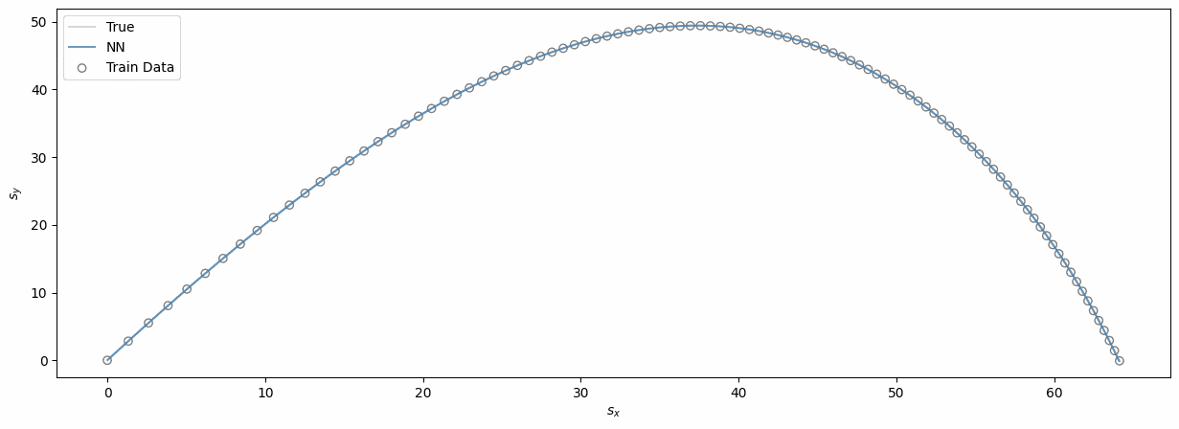
Supervised with „perfect“ data
Example: projectile motion (in free-fall)
https://towardsdatascience.com/physics-informed-neural-networks-pinns-an-intuitive-guide-fff138069563

Slide 47
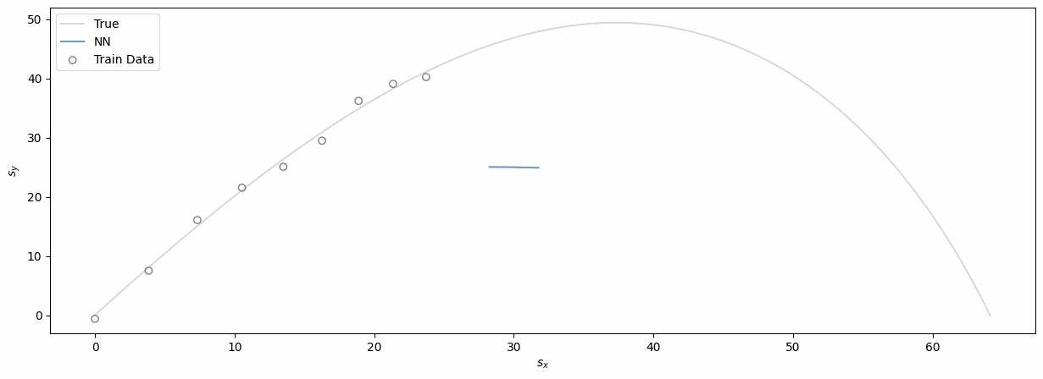
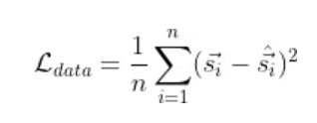
Realistic scenario: noisy, sparse and incomplete data
Example: projectile motion
https://towardsdatascience.com/physics-informed-neural-networks-pinns-an-intuitive-guide-fff138069563

Slide 48
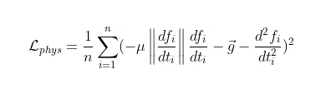
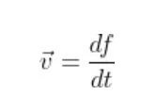
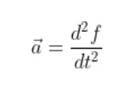
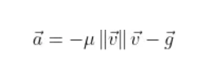
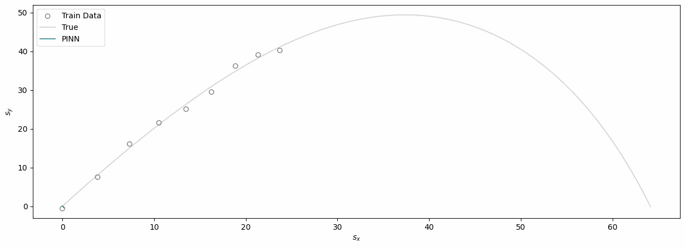
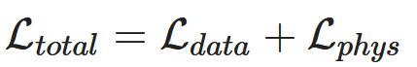
Modifying the loss-term with physical laws
https://towardsdatascience.com/physics-informed-neural-networks-pinns-an-intuitive-guide-fff138069563

Slide 49
Content
Machine Learning – Overview and Basic Understanding
Hands - On 1: Simple workflow for a classification task
2. The heart of Machine Learning: Fitting a Regression
3. Focus: Neural Networks
Hands - On 2: Linear regression from scratch
4. Short Excursion: Dependable Machine Learning
5. Short Excursion: Physics - Informed Deep Learning

Slide 50

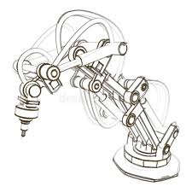







BAuA: AI Team in Dresden
Challenge:
Risk assessment of machines with AI in safety-relevant functions
AI team since 2022 in Dresden
AI-Team Dresden
S.Vock
materials scientist
team leader
Weija Shao
PostDoc
informatics
from Oct. 2023
M. Alipour
PostDoc
mathematician
parental leave
S. Musavishavazi
PhD student
mathematician
since september 2022
S. Jacob
PhD student
mathematician
since April 2023
F. Wolny
physicist
since January 2023
G.Siedel
Mechanical engineer
PhD student
since 2021

Slide 51











Helpful tools
Google colab

Slide 52
References and reading suggestions
monographs
Thomas Nield | Essential Math for Data Science | O‘Reilly | 2022 | intro + python intro
Kush Varshney | Trustworthy Machine Learning |  | 2022 | overview of methods for dependability and trustw.
Erdmann et al. | Deep Learning in Physics Research | World Scientific Publishing | 2021 | Intro + special physics examples
Raschka and Mirjalili | Python Machine Learning | Packt> | 2019 | comprehensive intro + advanced topics
Huang et al. | Machine Learning Safety | Springer | 2023 | Overview topics for safe/trustworth./dependable ML

Slide 53
References and reading suggestions
websites
https://towardsdatascience.com/physics-informed-neural-networks-pinns-an-intuitive-guide-fff138069563
→ short intro
https://deeplearningforphysicsresearchbook.github.io/deep-learning-physics/
→ comprehensive intro to ML and examples in physics + excercises and solutions in python
https://physicsbaseddeeplearning.org/intro.html
→ Comprehensive and advanced intro to deep learning in context of physical simulations

Slide 54


Further references
Icons made with:
www.flaticon.com
Help with coding and commenting:
https://chat.openai.com/

Slide 56
Machine Learning – Basic Workflow
alternative evaluation methods:
simulations
manually with expert knowledge
additional measurements
classical algorithms
…
Labels
Training Data
Machine Learning Algorithm
New Data
Predictive Model
Prediction
Raschka, Mirjalili, Python Machine Learning, Packt 2019

Slide 57
Data types
tabular
graphs
signals
sequences
Static
tabular data
Time
series
Event streams
social
networks
physical networks
images
audio
video
Natural language
Bio- logical se-quences
Software source code
Varsheney, Trustworthy Machine Learning, independently published 2022

Slide 58
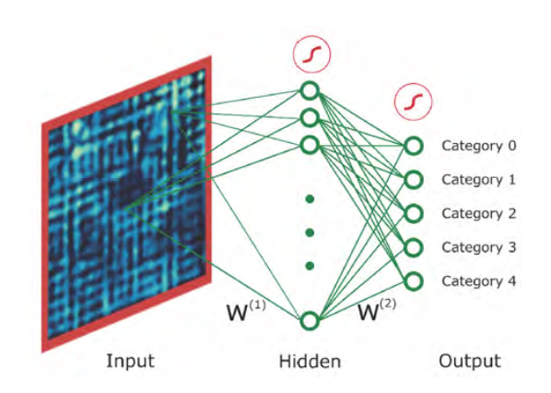
Data and tasks in physics research: STM image classification
Carleo et al., Machine learning and the physical sciences,10.1103/RevModPhys.91.045002,2019
Data:
STM images of superconductors
Task:
classification according to distinct types of spatial modulations

Slide 59
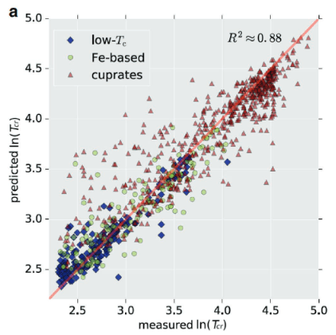
Data and tasks in physics research: Predicting T_{cr} of superconductors
Chen, Chi, et al. "A critical review of machine learning of energy materials." Advanced Energy Materials 10.8 2020
Data:
material data bases (e.g. SuperCon) extended by non-superconducting materials
and structural information (lattice parameters, band structure,…)
Task:
predicting T_{cr}

Slide 60
The heart of a Neural Network
Thomas Nield, Basic Math for Data Science, O‘Reilly 2022, p. 157
Machine Learning is Fitting a Regression
This is the heart of „training“ a machine learning algorithm. We provide some data and an objective function (the sum of squares) and it will find the right coefficients m and b to fullfill that objective. So when we „train“ a machine learning model we really are minimizing a loss function.
Content of 2nd part:
Basics of linear regression
Content of 3rd part:
How does this translates into neural networks?

Slide 61


Regularization with parameter norm penalties
L1-norm penalty
L2-norm penalty
L1 term pushes W1 to zero
L2 term motivates the reduction of weights, especially the large W1 weight
https://www.researchgate.net/publication/355020694_Deep_learning_models/figures?lo=1

Slide 62

Convolutional Networks
reconstruction tasks → pixel-wise regression:
pixel-wise prediction of the local densities of states from a topograph
topographic image
band gap
Erdmann et al., Deep learning for physics research, World Scientific, 2021

Slide 63
Model training,validation and test procedure
Source data
training data
validation data
test data
training
hold-out
cross-validation
bootstrapping
…
models
validation
final model
best model
testing

Slide 64


Application 1: Different networks for different physical tasks
Fully connected networks:
classical network architectures
without taking locality properties and symmetries into account
Tasks:
simple image classification
regression
E.g.:
classification of magnetic phases
High-temperature state
Ising square-ice ground state
Carrasquilla and Melko, Machine learning phases of matter, Nature Physics Letters 2017

Slide 65

Application 3 : Different models for different physical tasks
Recurrent neural networks:
elementary networks for processing sequential data
alternative to feedword networks that takes into account already stored elements when processing new ones
additional memory called internal state
Tasks:
Nonlinear time series
Outlier detection
Nonlinear dynamics
E.g.:
physics-informed spatio-temporal approach for crack growth and propagation: track time evolution of stress and damage in a simulated material
y_{t}
h_{t-1}
h_{t}
x_{t}
Mehta et al., Physics-Informed Spatiotemporal Deep Learning for Emulating Coupled Dynamical Systems. In AAAI Spring Symposium: MLPS 2020

Slide 66
ε
2r
Class 1
Class 2
[Yang et al.: „A Closer Look at Accuracy vs. Robustness”, 2020]
Input Parameter 2
Input Parameter 1

Slide 67
εmin
2r
Class 1
Class 2
[Yang et al.: „A Closer Look at Accuracy vs. Robustness”, 2020]
Input Parameter 2
εmin = r
Input Parameter 1

Slide 68



εmin
2r
MSCR… Minimal Separation Corruption Robustness
$$\text{MSCR} \text{= }\frac{\left(\text{Acc}\text{robust} \text{− }\text{Acc}\text{original} \right)}{\text{Acc}\text{original} }$$
Input Parameter 2
100% $\text{Acc}\text{original}$ > $\text{Acc}\text{robust}$
→ MSCR < 0
100% $\text{Acc}\text{original}$ = 100% $\text{Acc}\text{robust}$
→ MSCR = 0
Input Parameter 1

Slide 69

Uncertainty Quantification
Bagging + Boosting

Slide 70

Uncertainty quantification

Slide 71




Calibration
In calibration we try to improve our model such that the distribution and behavior of the probability predicted is similar to the distribution and behavior of probability observed in training data
https://medium.com/analytics-vidhya/calibration-in-machine-learning-e7972ac93555

Slide 72

Data and tasks in physics research: Magnetic phases
https://nbviewer.org/github/DeepLearningForPhysicsResearchBook/deep-learning-physics/blob/main/Exercise_08_1_solution.ipynb
Data:
MC simulation of magentic dipole moments on square lattice at given temperature T
Task:
classification of magnetic phases (pm/fm)
prediction of T_{c}

Slide 73
Accuracy-Robustness-Tradeoff?
Optimum
Siedel, Georg, et al. "Utilizing class separation distance for the evaluation of corruption robustness of machine learning classifiers." arXiv preprint arXiv:2206.13405 , 2022

Slide 74

Receiver Operator Characteristics (ROC)/Area Under Curve (AUC)
ROC
AUC
ROC
True Positive Rate
AUC
False Positive Rate
https://commons.wikimedia.org/wiki/File:Roccurves.png

Slide 75

Dependable machine learning: overview

Slide 76
Dependable machine learning: overview
physicist
material scientist
…

Slide 77
Dependable Machine Learning
ML lifecycle elements
specification
data handling
model building
evaluation/
validation
testing
deployment
ML dependability elements
robustness
generalizability
explainability
uncertainty quantification

Slide 78
specification
data handling
model building
evaluation/
validation
testing
deployment
training data augmentation
…
…
…
…
test data augmentation
robustness
anomaly detection
neural coverage
…
bias, variance, confusion matrix…
drift detection
…
…
regularization
generalizability
formal verification
methamorphic testing
…
…
feature importance
…
…
…
explainability
surrogate models
…
…
…
uncertainty quantification
Bayesian methods
Ensemble methods
calibration error

